Slide 1
Identifying Key Issues and Trends Related to a Country from News Reports

Slide 2
Table of contents
Key Findings
Key Issues
Time Analysis
News Outlet Analysis
Entities Analysis
Others
Methodology
Overview
How to represent an issue
Topic model
Tuning topic model
Text data cleaning
Other analysis

Slide 3
Key Findings

Slide 4
Top 5 Key Issues
Top Issue | Example (title) of this issue

Slide 5
Key Issues In Specific Timelines

Slide 6
News outlet analysis
News outlet is defined by the domain name of the news article
Therefore, the same news outlet with different domains may be treated differently (ie. yahoo.com vs in.yahoo.com)

Slide 7
Entities Analysis

Slide 8
Other Key Findings

Slide 9
Methodology

Slide 10
Overall Methodology
Data Understanding
What is the distribution of each data field, and across time?
Can we extract some features (NER, keywords, sentiments) to understand text data?
Literature Review
What does the common methods to tackle this problem?
Modelling (Unsupervised)
Cluster articles into similar topics + extract keywords per topic
Data Cleaning
Perform model selection
Model tuning
Further Analysis
Keyword selection
Time series analysis
News outlet analysis
Filtering for related news

Slide 11
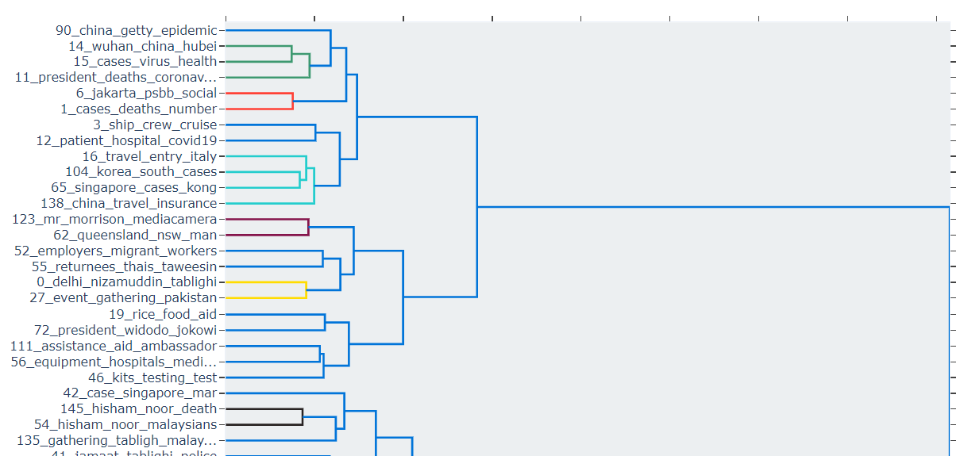
How To Represent a Topic or issue
Key Phrases
Hierarchy and Combination
Sentence
Example: Covid-19, economy
How can we extract key phrases?
Document level
Graph algorithms: TextRank
Zero shot summarization
NER
Cluster of Documents
- Topic modelling: LDA, NMF, BERTopic
Example: Economy under covid-19 (which is under health
How?
Hierarchical labelling (IAB)
Hierarchical clustering (Topic models)
Example: Covid-19 have resulted in economic downturn in the tourism industry.
Zero-shot Summarization of a cluster of documents
Extraction of key sentences per article
(not performed)

Slide 12
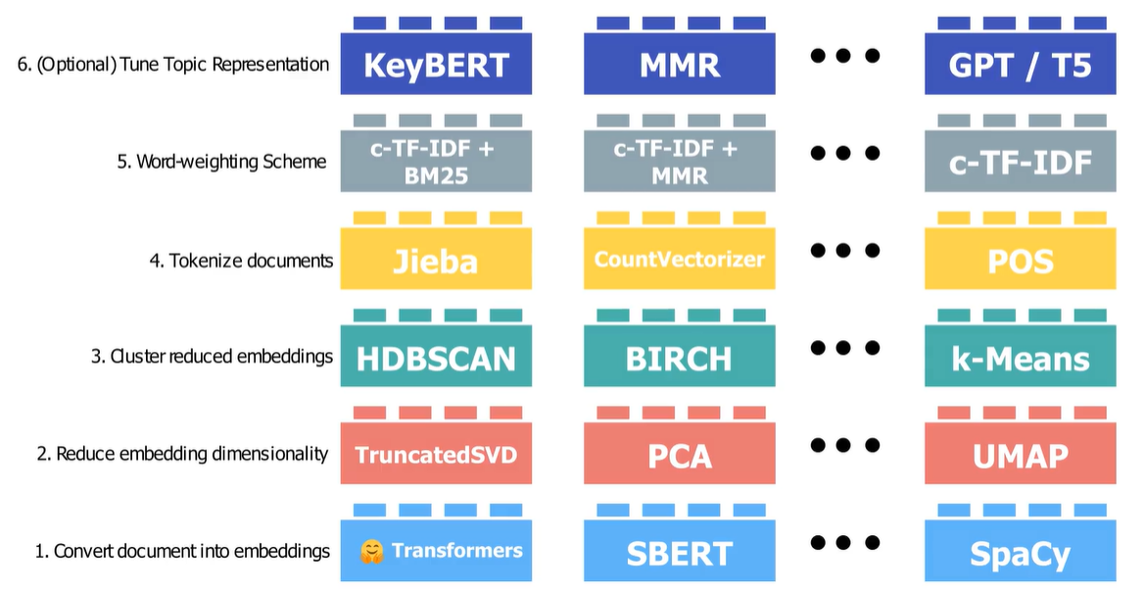
Topic Model Utilized
Why BERTopic is utilized?
Explainable models include NMF and BERT
Coherence Score is poor (0) for NMF
Ability to utilize embeddings
Notes:
Coherence Score - measures the degree of semantic similarity between the top words in a topic (Using TF-IDF)
For example, if a topic consists of the words "apple, fruit, tree, red, and sweet," the coherence score would measure how well these words are related to each other in a semantic sense.
In NMF, the matrix of term frequencies in the documents is factorized into two non-negative matrices - a document-topic matrix and a topic-term matrix.
LDA works by iteratively updating two sets of parameters - the topic-term matrix and the document-topic matrix - until a stable solution is obtained. The algorithm starts by randomly assigning each word in each document to one of the topics, and then iteratively updates the probability distributions until convergence. During each iteration, the algorithm computes the probability of each word in each document belonging to each topic and updates the document-topic matrix accordingly. It then computes the probability of each term belonging to each topic and updates the topic-term matrix accordingly.
In c-TFIDF, the term frequency of a term in a document is weighted by its inverse document frequency, as in the traditional TFIDF scheme. However, the inverse document frequency component is also weighted by a measure of the context in which the term appears. The context is defined as the set of other words in the document that co-occur with the term.
KeyBERT works by first embedding each sentence in the document using a pre-trained BERT model. It then calculates the sentence embeddings' similarity scores to each other to identify sentences that are most semantically similar to each other. The algorithm then selects the top-n most similar sentences and extracts the keywords from these sentences using another pre-trained BERT model.
HDBScan works by first constructing a hierarchical representation of the data using a minimum spanning tree, which connects the data points with the shortest possible distances.

Slide 13
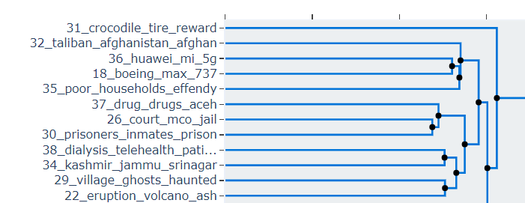
Tuning Topic Models
Outlier Documents
We can utilize similarity (c-TF-IDF vs BERT) to bring re-assign outlier documents to similar clusters
Number of Topics
Number of topics could be auto-assigned by BERTopic (158 topics) based on coherence score. However, it is hard to interpret so many topics
Reduce the number of topics gradually (158 -> 40) while keeping coherence score at a high level (0.68 -> 0.68)
Use hierarchical charts to determine if topics can be further combined.
Rice sugar coffee rendang
Nickel coal mine oil China

Slide 14
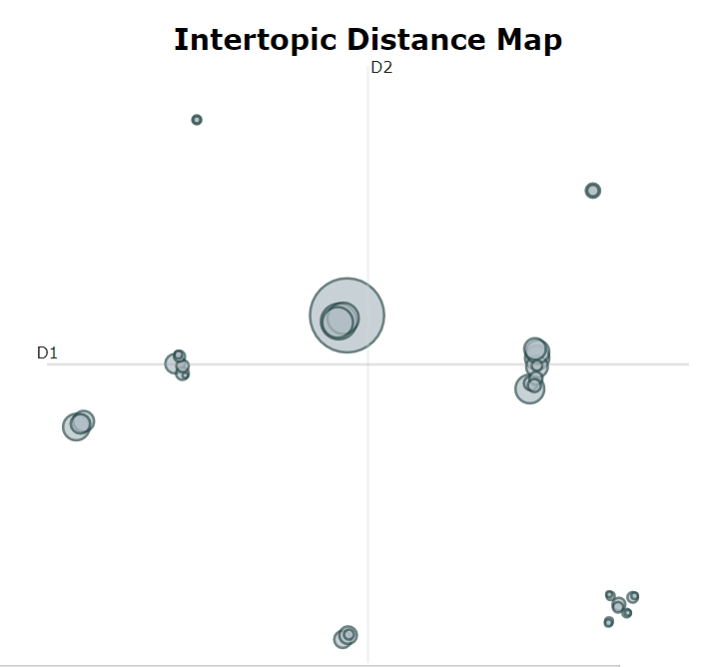
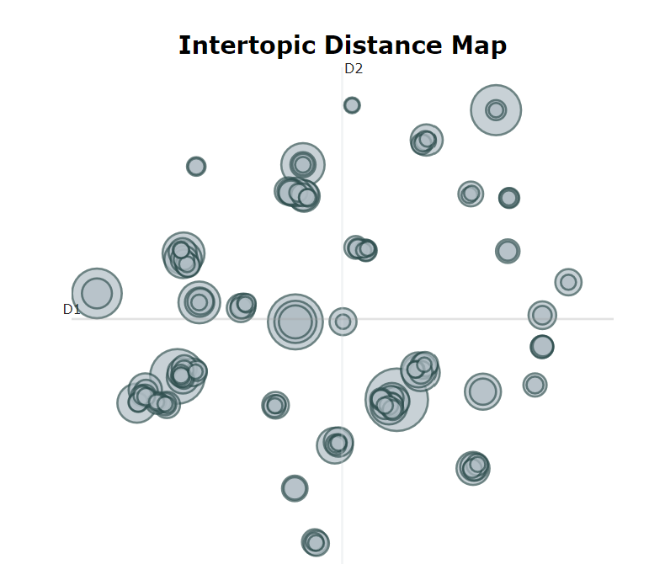
Tuning Topic Models
Number of Topics
Evaluate the improvement via the intertopic-distance maps
Before
After
Covid | Cases | Health | People
Sinaga | Manchester | Victims

Slide 15
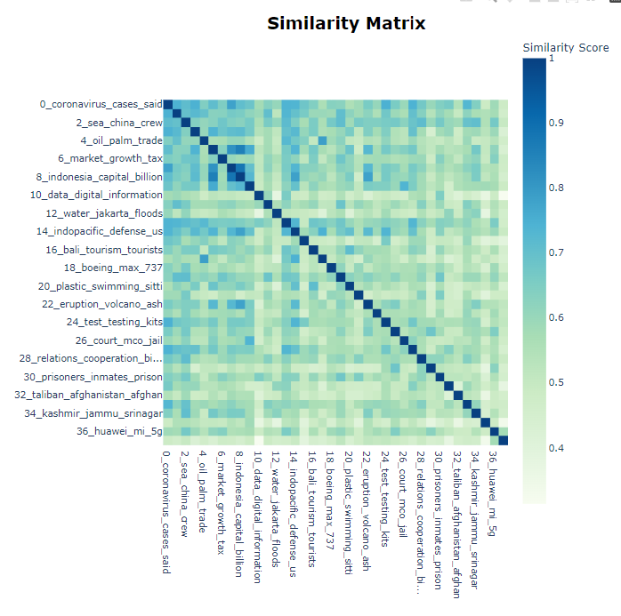
Tuning Topic Models
Number of Topics
Are there still any similar articles which we can combine?
Yes, however, it may not make sense to combine them. Ie covid19 + economy vs economy + banks
Can manually combine topics like power|energy|coal and oil|palm|trade, but there are not many to combine

Slide 16
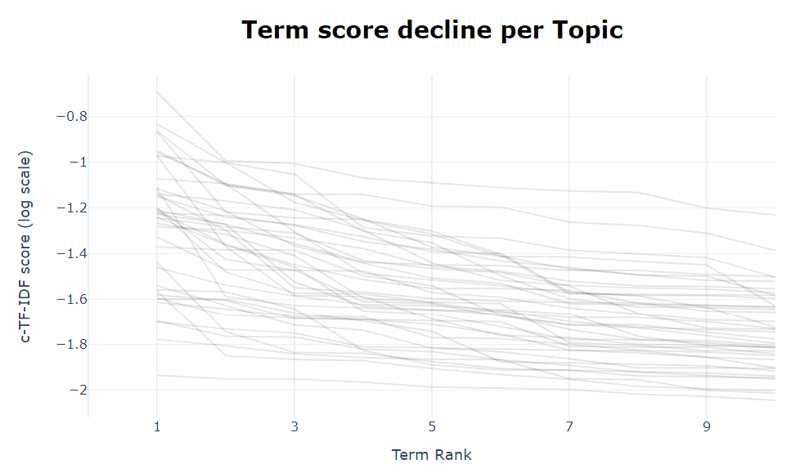
Tuning Topic Models
Number of Keywords
- Utilize c-TF-IDF score and elbow charts to determine the appropriate cut-off for keywords (4, globally)

Slide 17
Text Data Cleaning
Text data cleaning depends on the output of the specific analysis to be provided
For example, for BERT models, there are less data cleaning which needs to be done.
In general data cleaning steps include:
Remove URLs (usually not relevant to the analysis)
Removing new lines
Removing stop words
Stemming (removing suffixes)
Lemmatizing (converting to base form)

Slide 18
Further Analysis
Are there any other features within the text which can be utilized to gleam more information on the issues?
NER – using spacy library
Keywords – utilize textrank /positionrank model
IAB Classification using zero shot models
How?
We have the topic cluster assignment for each document in topic modelling. We can look at the top features extracted from topic models for each cluster.

Slide 19
Filtering for Related News
News related to Indonesia could be:
Local news
News which impact Indonesia/Indonesians (harder to evaluate)
Methods:
We look at the entities / keywords surrounding Indonesia using NER spacy library and textrank
Negative approach to reduce false positive – topics that have articles with few key words related to Indonesia, we will eliminate them

Slide 20
Normalizing News outlet coverage
There are 430 “duplicated” articles based on titles, which could be excluded
Question: What constitutes a key or important issue?
Number of news outlet reporting on the same topic
Number of viewers viewing the same topic (not available)
Impact of news article on the user (hard to measure)
Therefore, news outlet coverage can be normalized if we have other metrics available.

